Slide 1
The Metalizer Rocket
By: Matthew Escobar

Slide 2
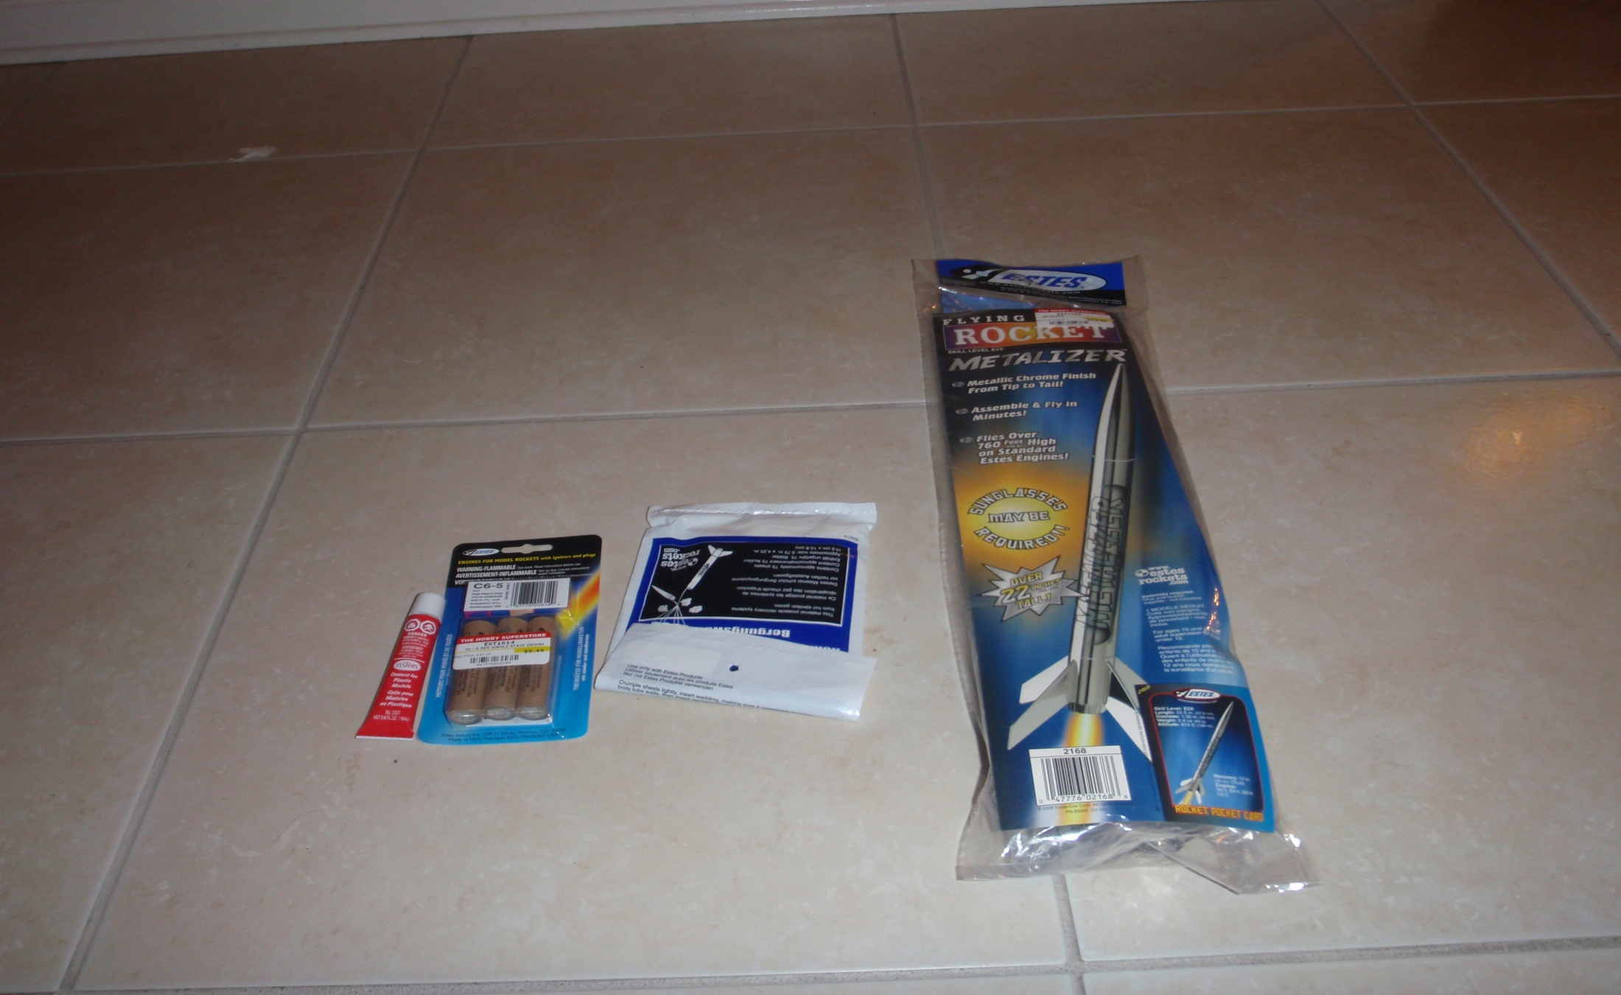
Here are the materials for the Rocket

Slide 3
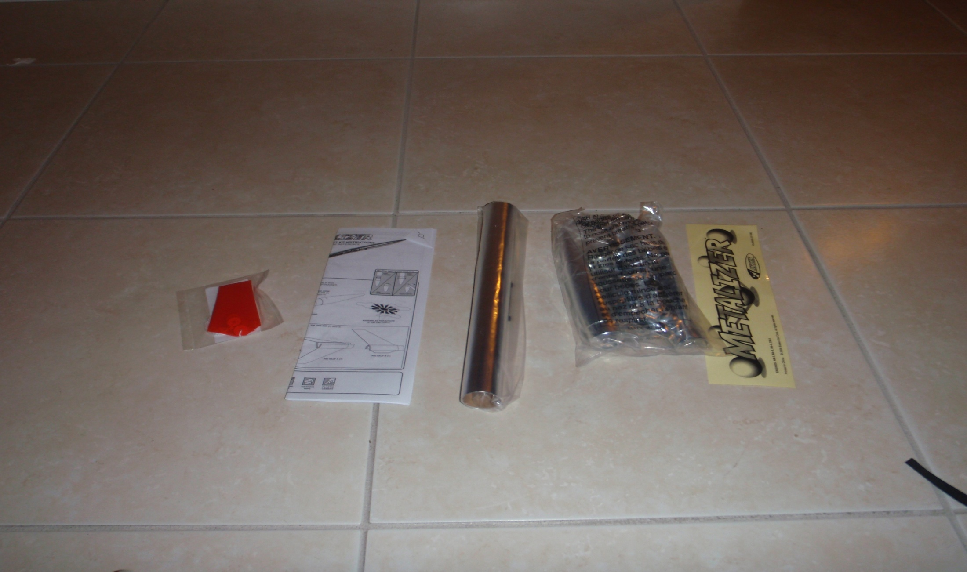
This is the Rocket

Slide 4
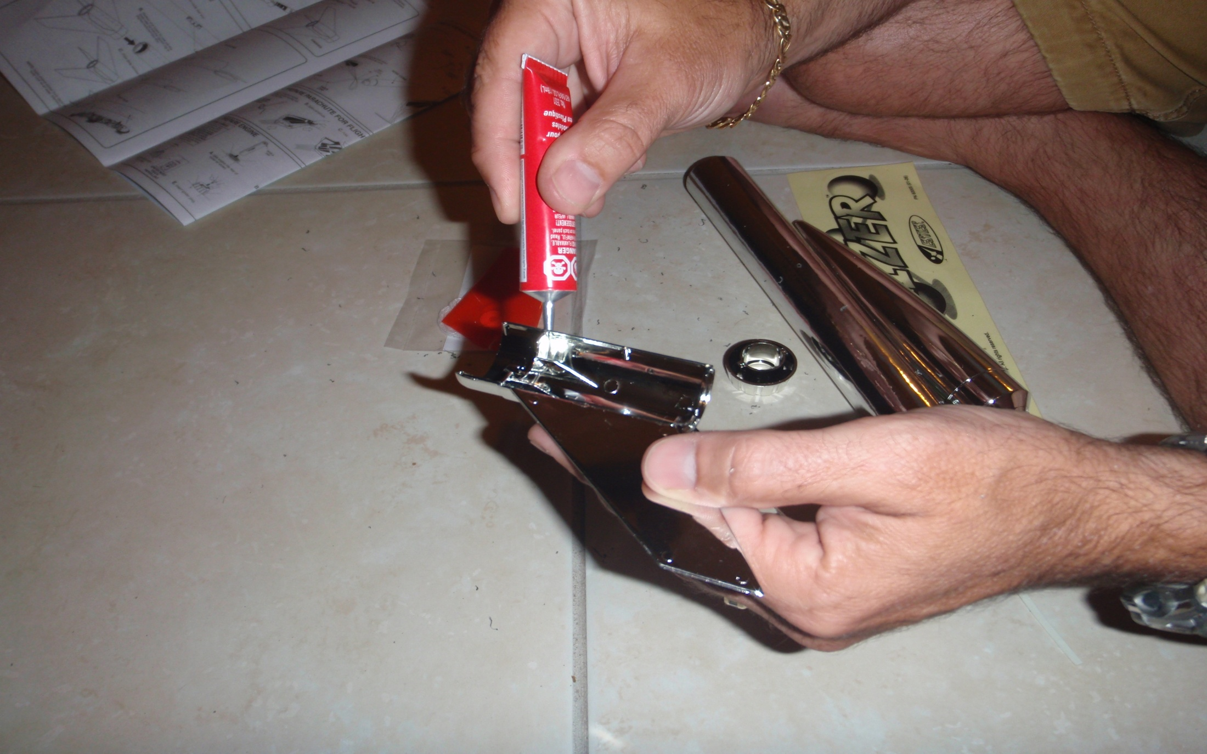
Here I am putting cement on the fins

Slide 5
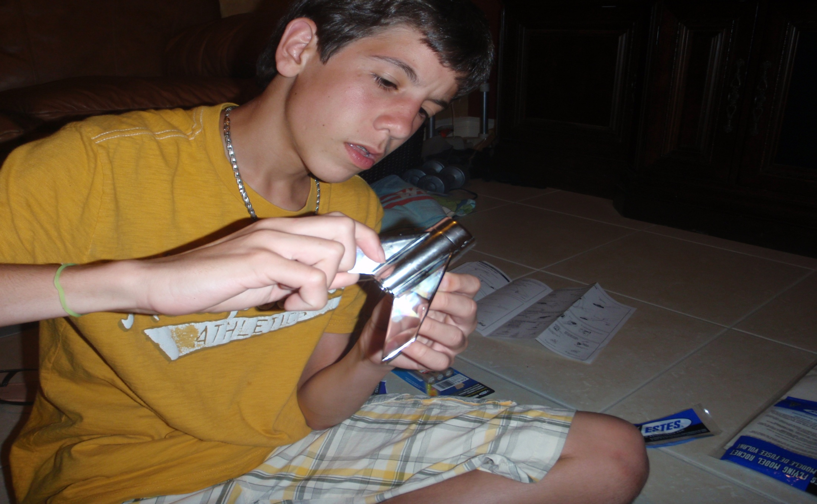
Here I am gluing the fins together.

Slide 6
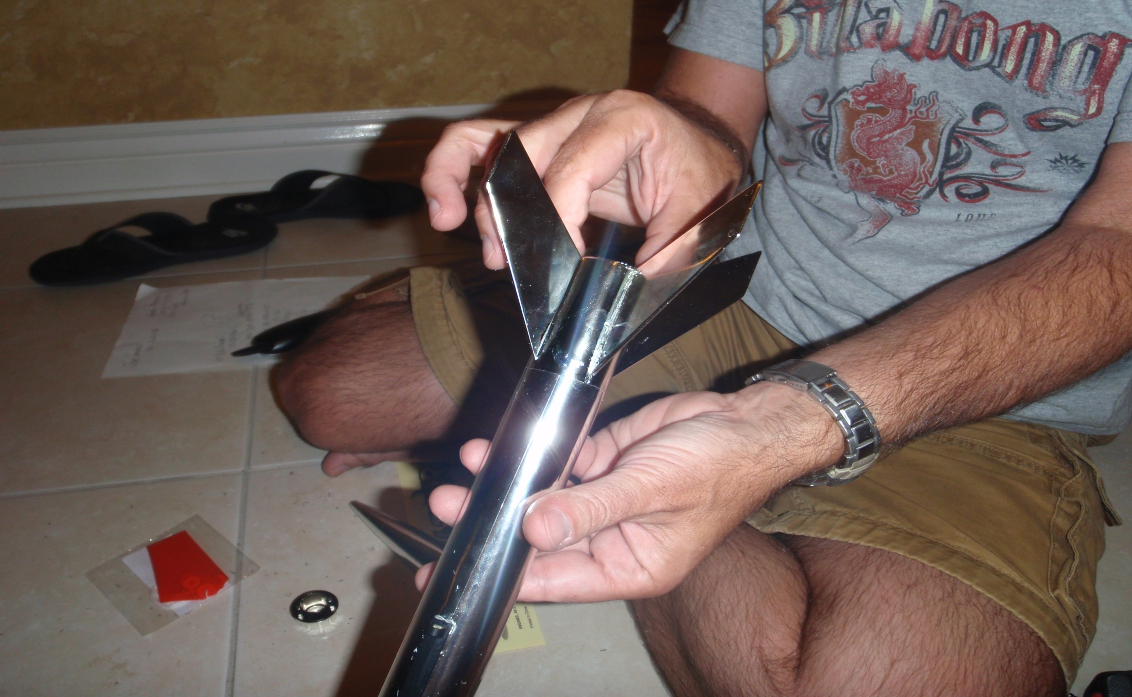
Here we connect the body tube to the Fins.

Slide 7
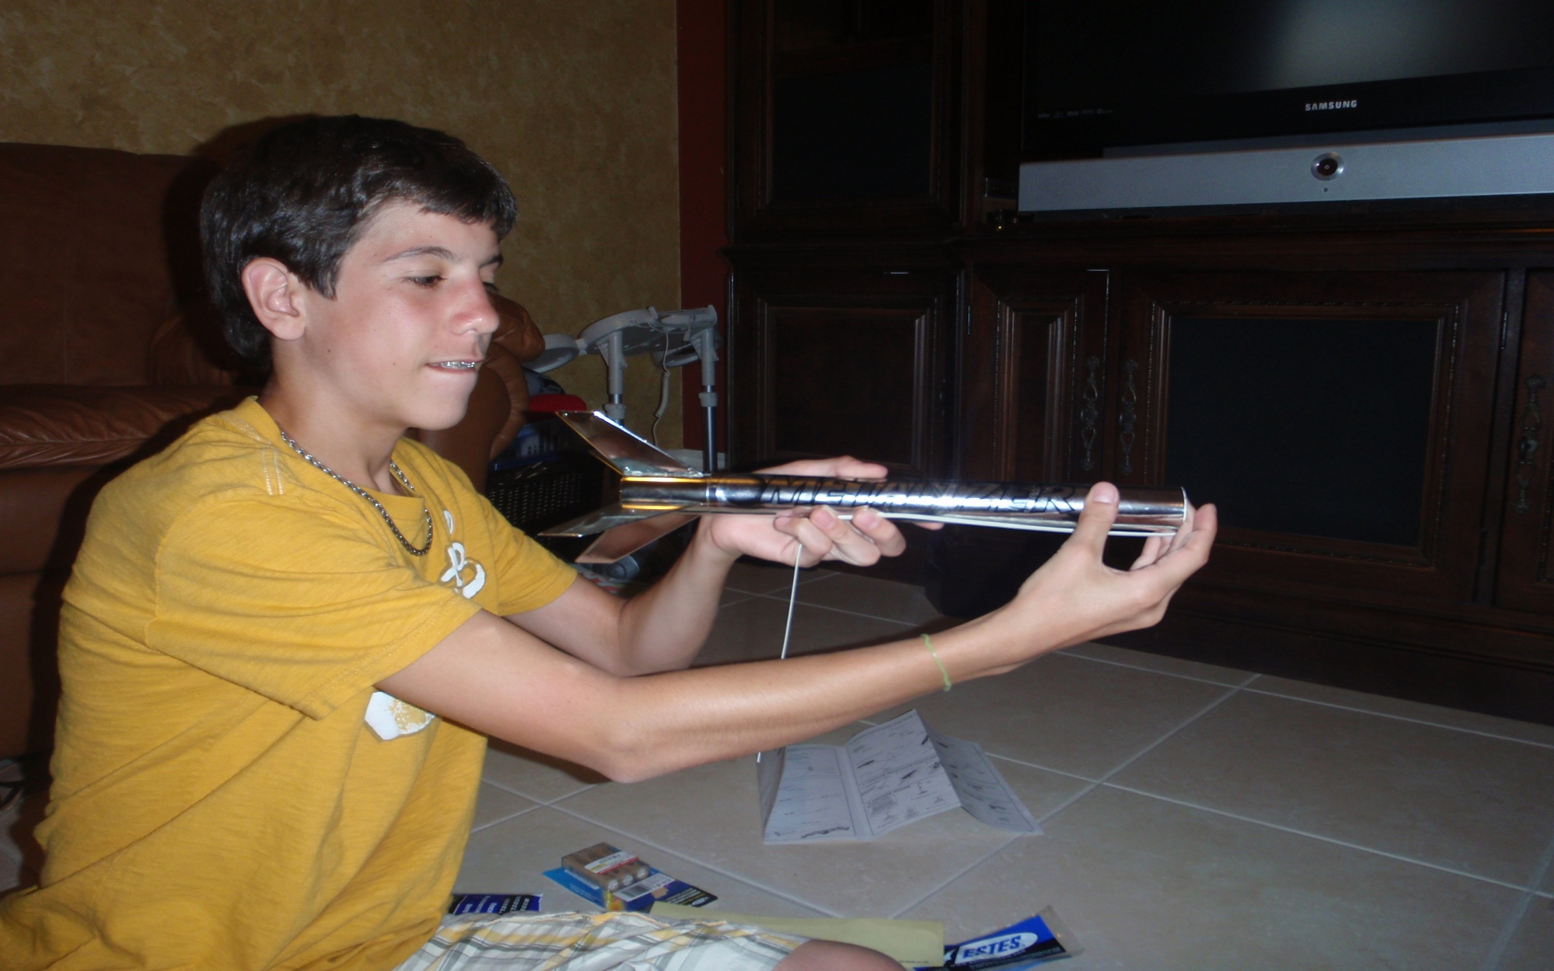
Putting on the decals.

Slide 8
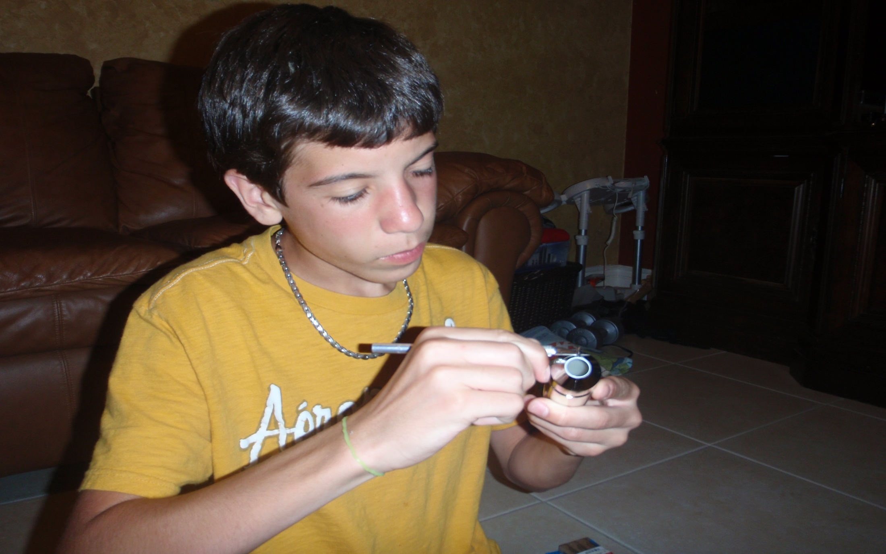
Cleaning out the eye of the nose cone.

Slide 9
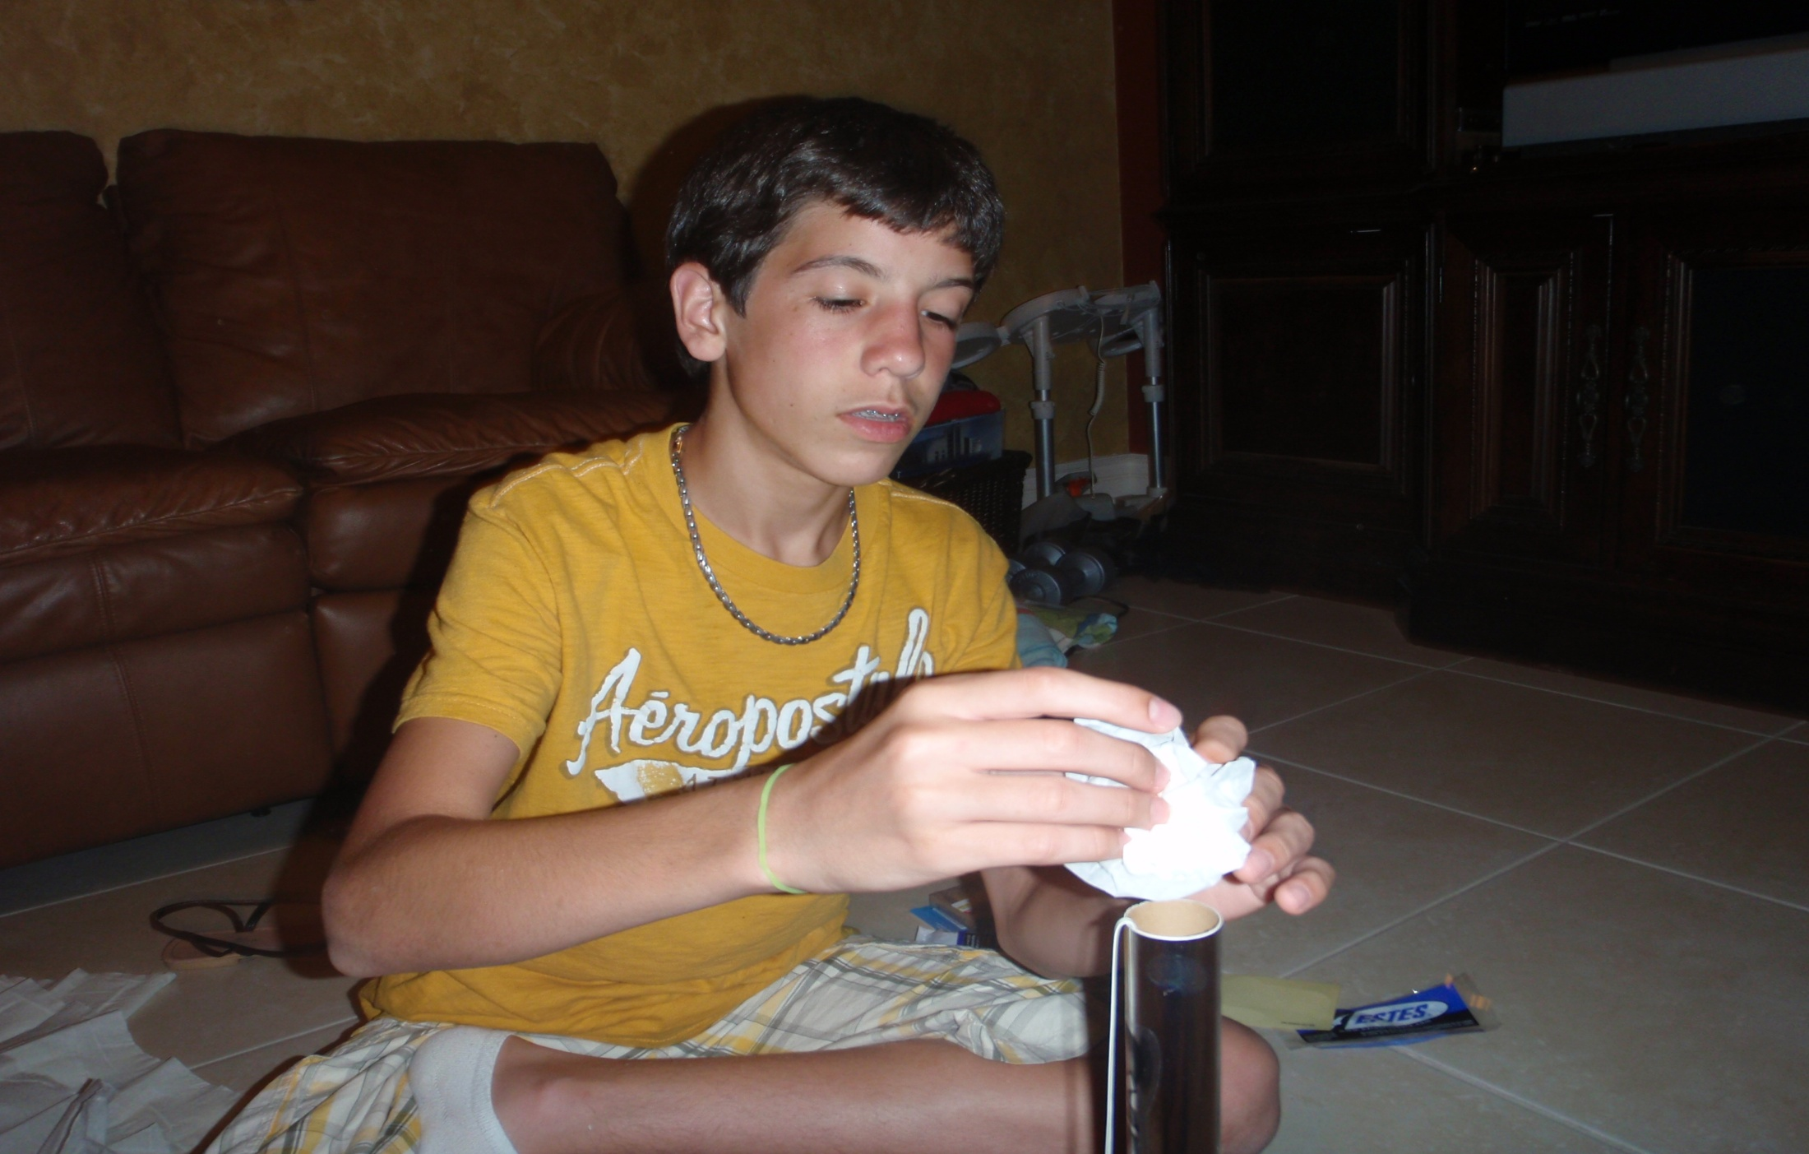
Inserting the recovery wadding.

Slide 10
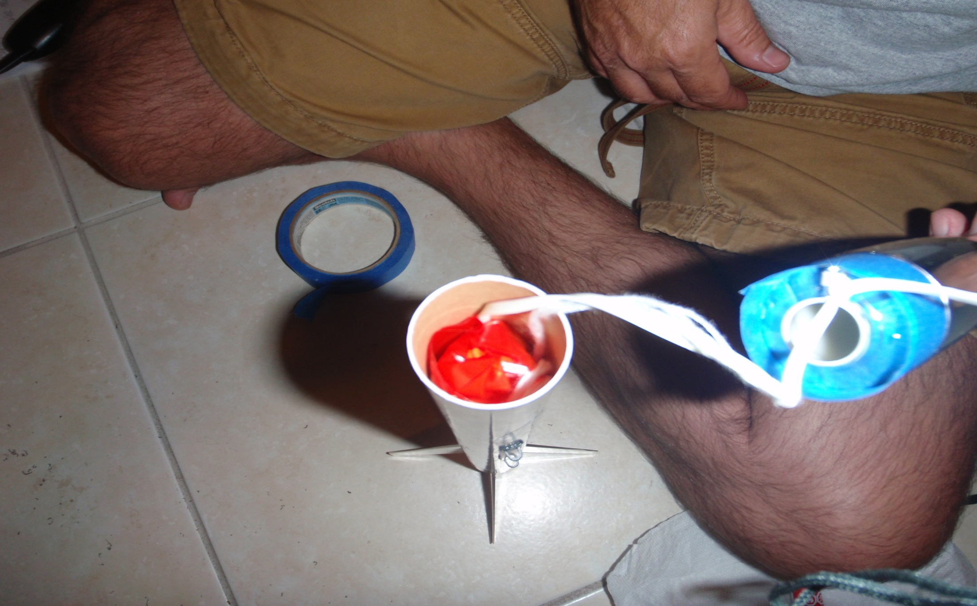
Inserting the parachute.

Slide 11
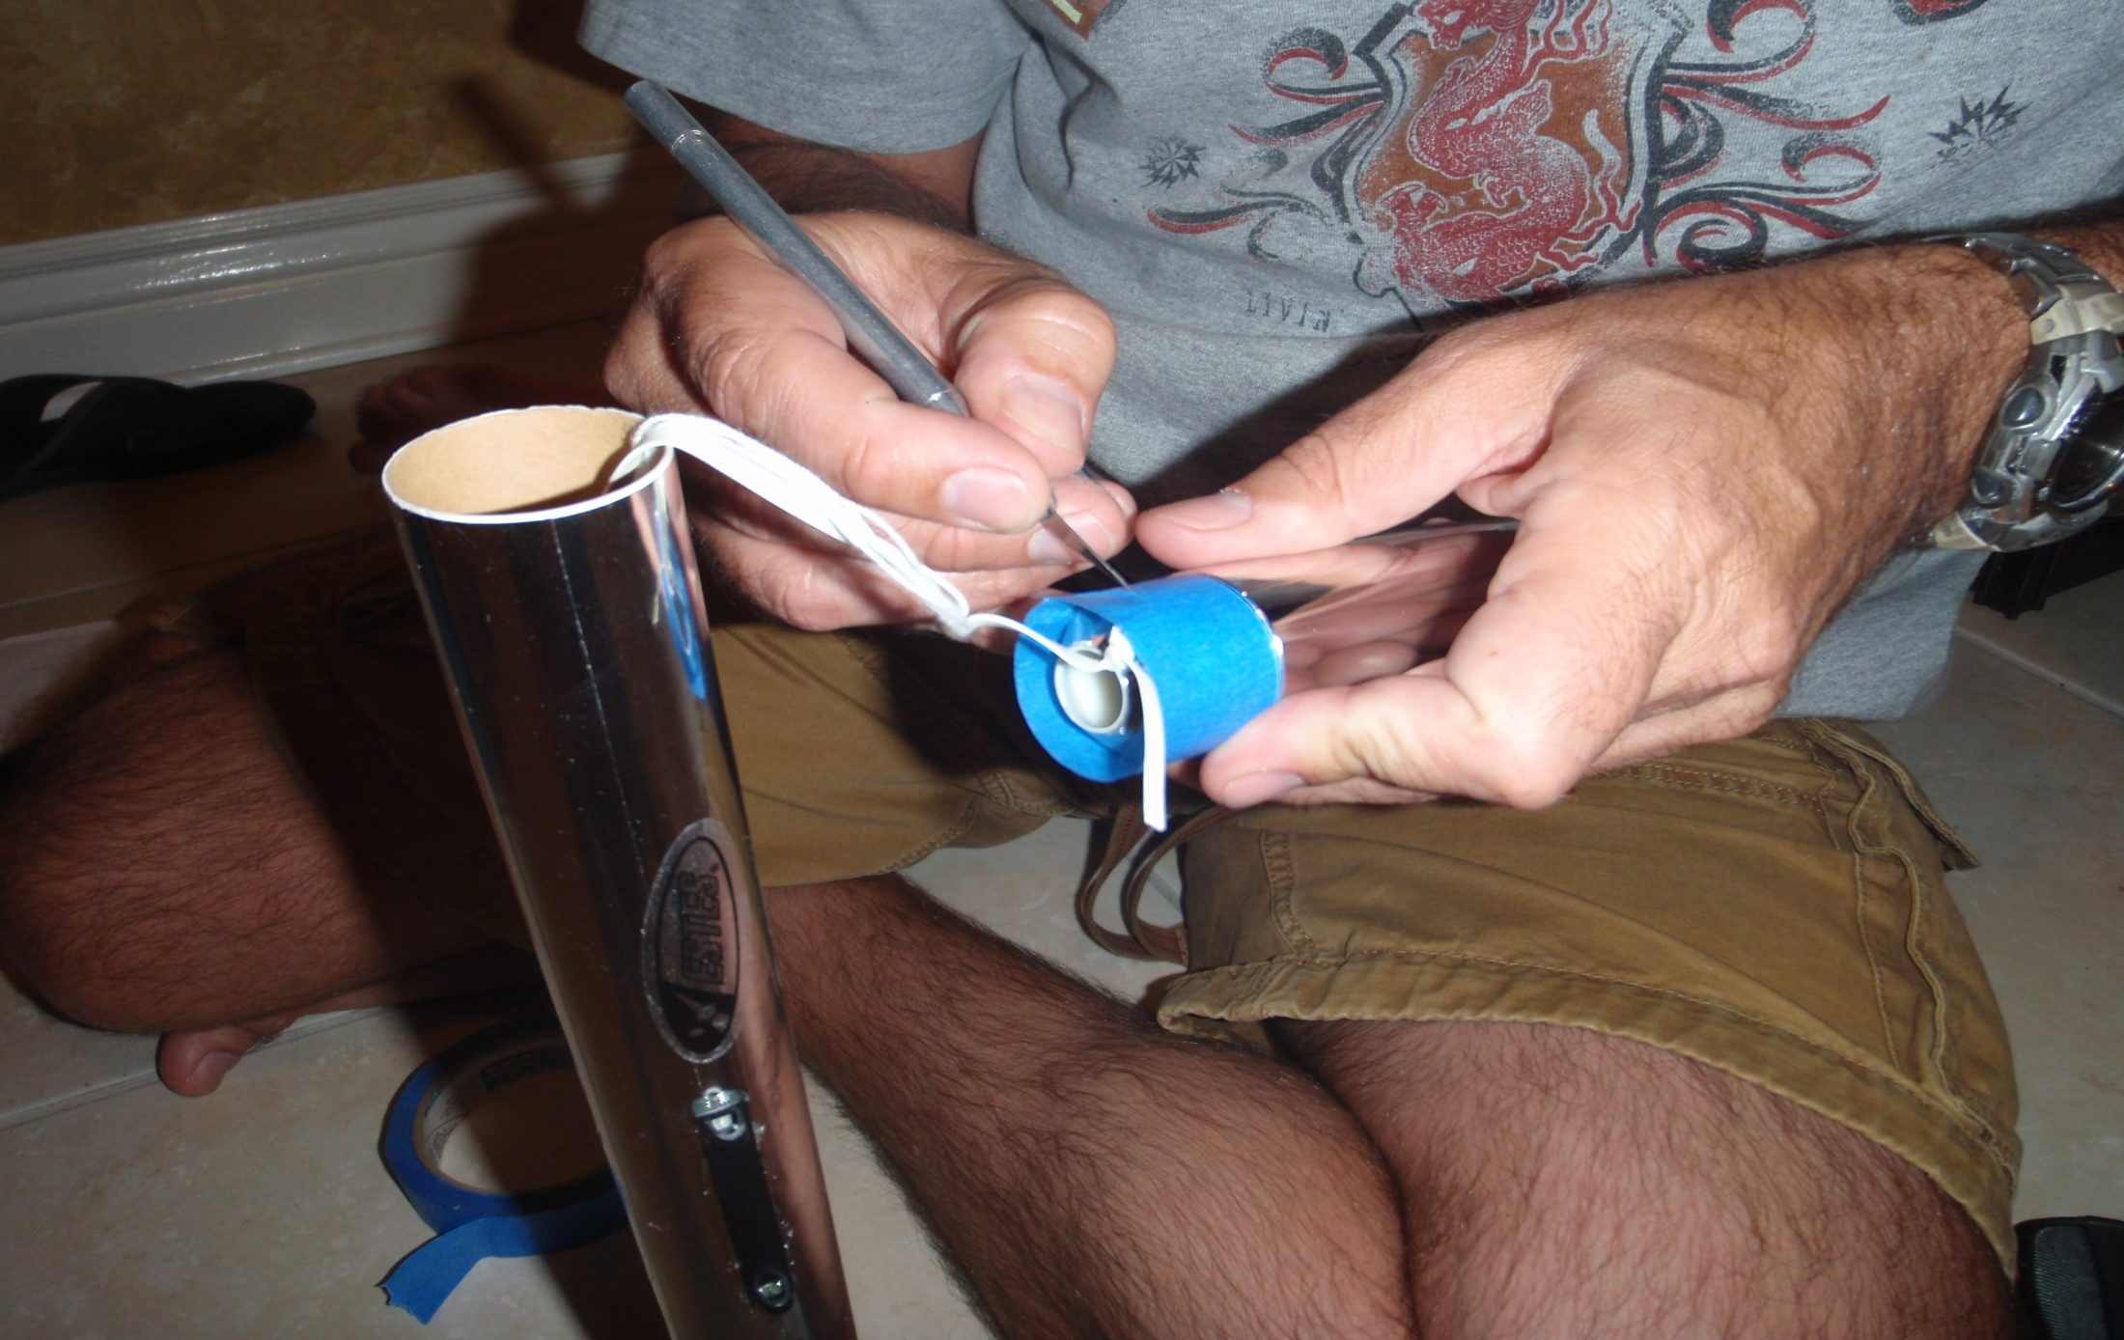
Making sure the nose cone has a tight fit.

Slide 12
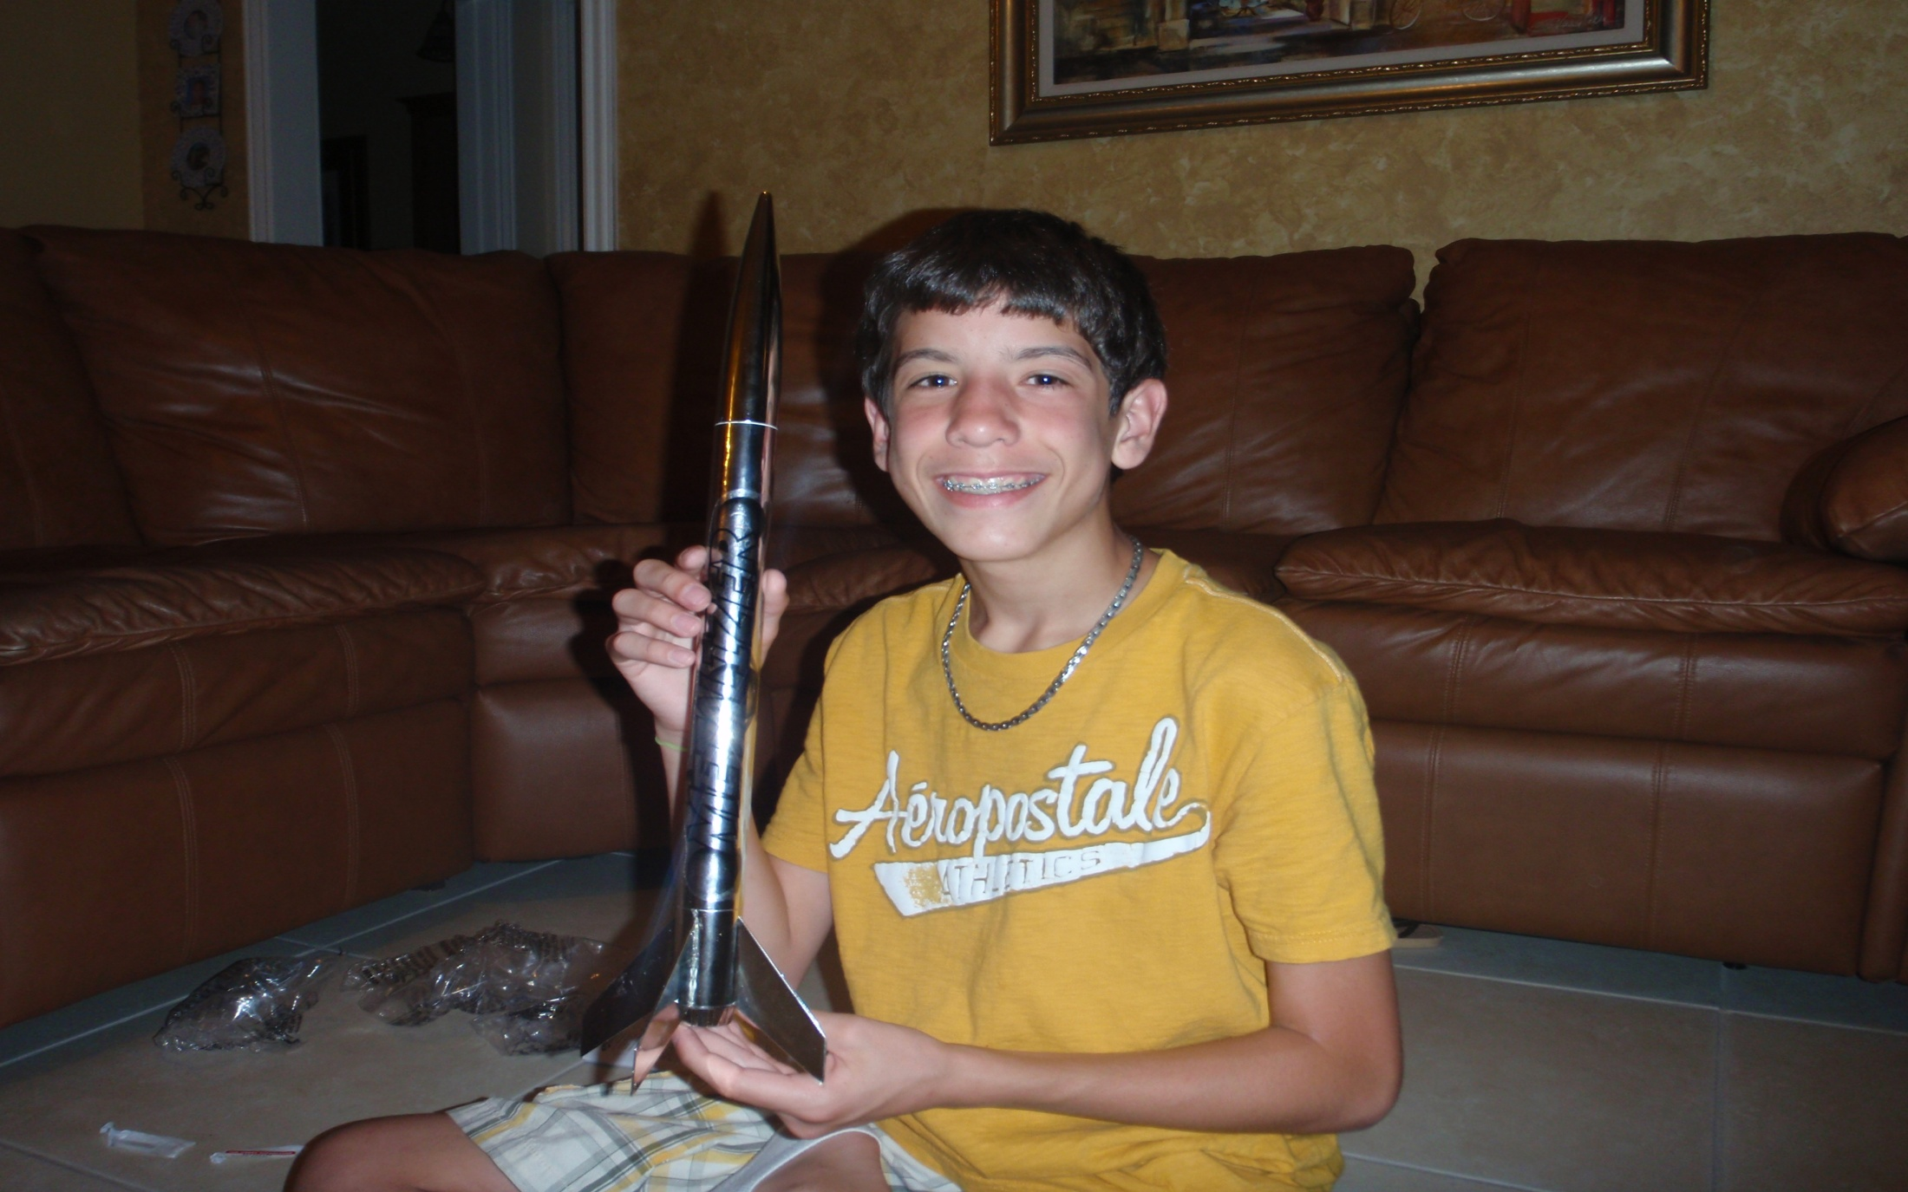
The finished product.

